Slide 1
Source Code document

Slide 2

Read the books dataset and explore it

Slide 3


Clean up NaN values

Slide 4
Read the data where ratings are given by users

Slide 5
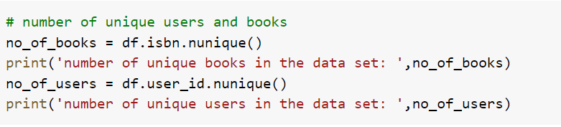
Take a quick look at the number of unique users and books

Slide 6
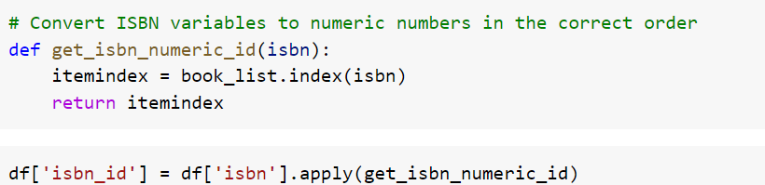
Convert ISBN variables to numeric numbers in the correct order

Slide 7
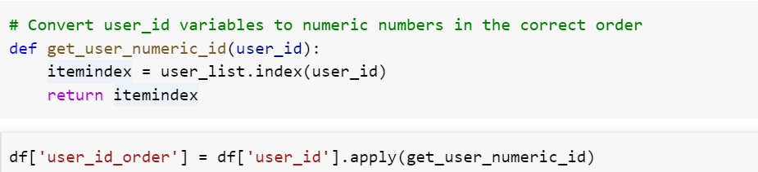
Convert the user_id variable to numeric numbers in the correct order

Slide 8

Convert both user_id and ISBN to the ordered list, i.e., from 0...n-1

Slide 9
Re-index the columns to build a matrix

Slide 10

Split your data into two sets (training and testing)

Slide 11
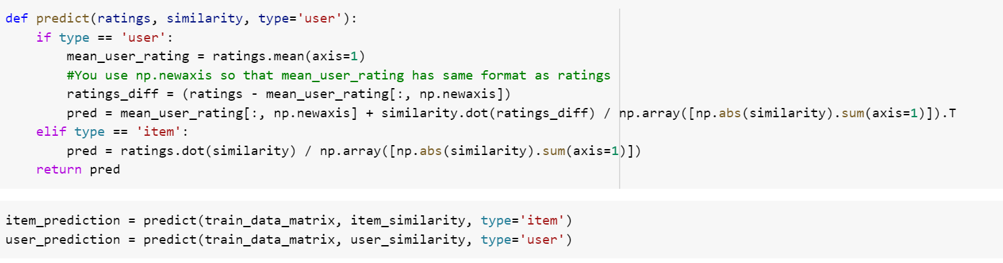
Make predictions based on user and item variables

Slide 12
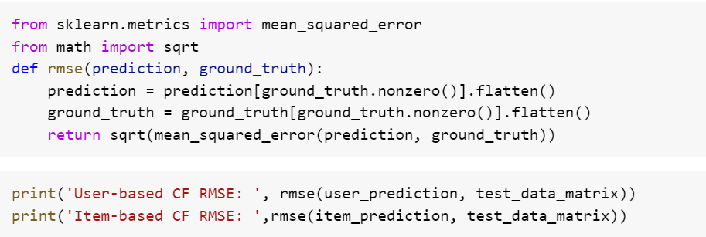
Use RMSE to evaluate the predictions

